Slide 1

SET YOUR CODE
ON FIRE
Michael Plank, MSc
FITC Toronto 2010

Slide 2
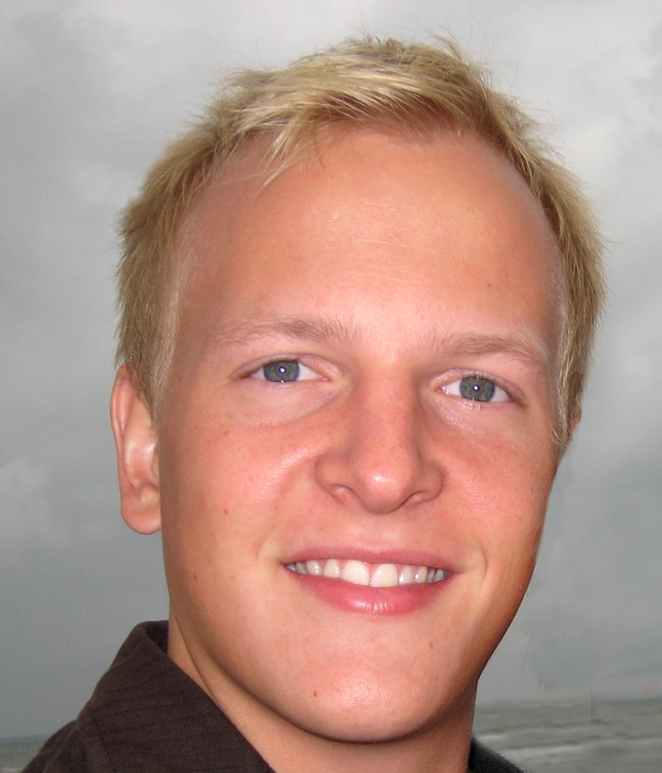

ABOUT
me and the company
Michael Plank
Evangelist, Developer
Powerflasher
Agency, Solutions, Labs

Slide 3
AGENDA
it‘s all about FDT
Speed up Coding
What‘s new in 3.5
Sneak Peek

Slide 4






SURVEY
your favorite editor

Slide 5
SURVEY
your favorite editor
4
5
6
4
0
10

Slide 6
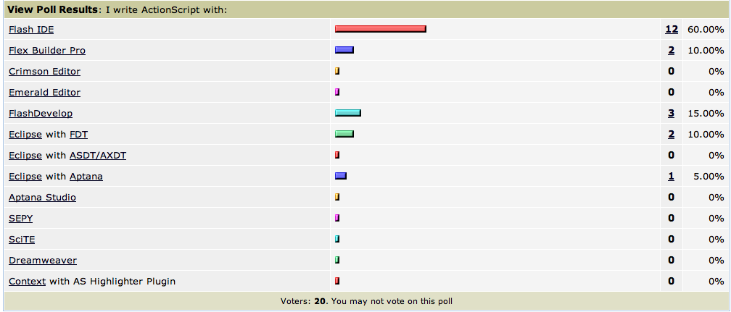

Slide 7
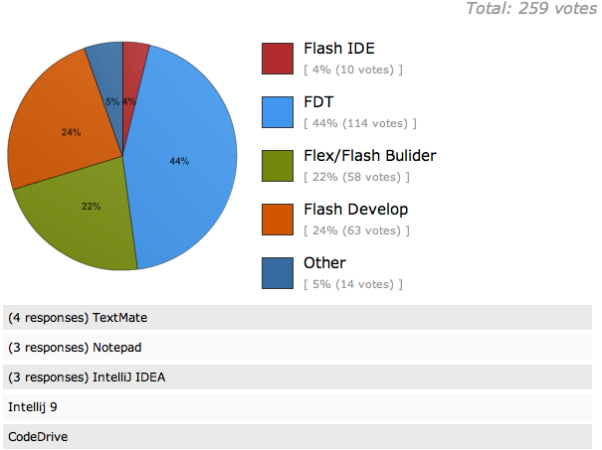

Slide 8
FEATURE DEMO
why FDT rocks

Slide 9
WHAT‘S NEW
in FDT 3.5

Slide 10
WHAT‘S NEW
in FDT 3.5
Full MXML support

Slide 11
WHAT‘S NEW
in FDT 3.5
Full MXML support
New Autocompletions

Slide 12
WHAT‘S NEW
in FDT 3.5
Full MXML support
New Autocompletions
New Debugger

Slide 13
WHAT‘S NEW
in FDT 3.5
Full MXML support
New Autocompletions
New Debugger
Improved Quick Outline

Slide 14
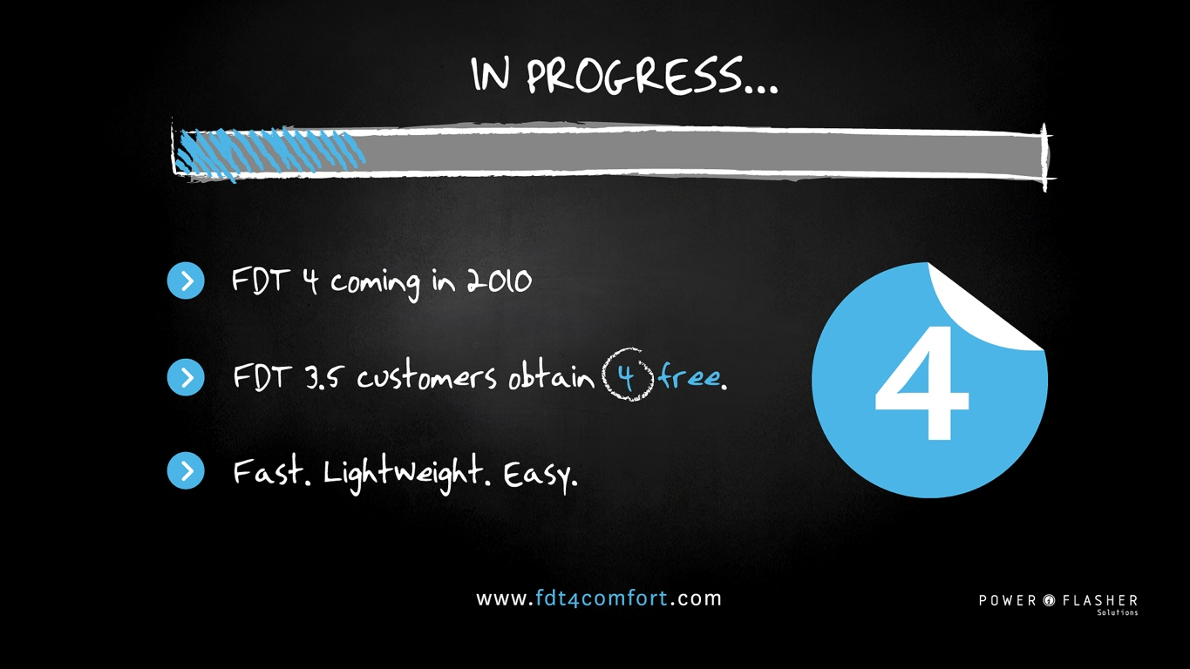


Slide 15
ROADMAP
FDT 4 milestones
FDT 4
M1 M2 M3 M4 RC 4.0

Slide 16
ROADMAP
FDT 4 features
M1
M2
Labs
Profiler
Welcome Screen
SDK Management
Project Setup
Framework Support
Haxe Support
Dependency Vis.
Unit Testing
Linux Support
M3
M4
Flex 4
Formatter
Lib Management
Compiling

Slide 17
LIVE DEMO
FDT 4

Slide 18
LIVE DEMO
FDT 4
Welcome Screen
Profiler
M1

Slide 19
LIVE DEMO
FDT 4
Welcome Screen
Profiler
New SDK Management
Projet Setup/Templates
M1
M2

Slide 20
FDT LABS
The plugin community
Community plugins
Central update site
Open Source
Tutorials, Samples, ...

Slide 21
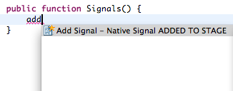

Slide 22
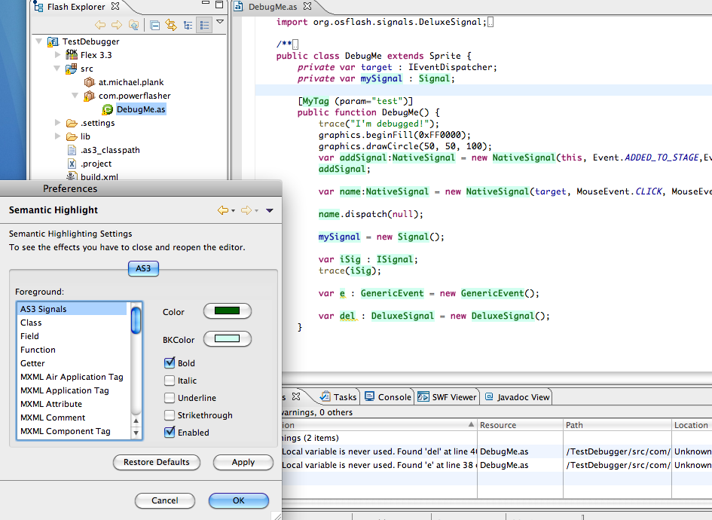

Slide 23
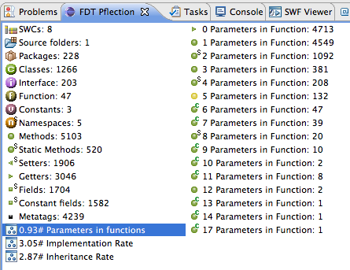

Slide 24
TRY IT NOW
FDT 4 Milestone 1
www.fdt4comfort.com
At the booth

Slide 25



CONTACT
twitter, mail, web
@Michael_Plank
mp@powerflasher.at
fdt.powerflasher.com

